Slide 1
Smart Door Lock
19BCT0082
Jasshu Garg

Slide 2
Refined Problem Statement
As we know, security is a defence practice to against the threats. In order to keep our valuable items safe, we use security. We also use various levels of security in our devices to protect the confidential data. Similarly, our houses, offices, hospitals also need security. A multi factor security solution is proposed which can authenticate, authorize and validate the user and open the door for the user after three types of verification. The door will be unlocked when the user passes RFID identification, filling correct passcode. The main aim of proposing this solution is using the current available technology and providing a security which can really maintain the confidentiality and integrity.

Slide 3
Proposed Solution
To the defined problem

Slide 4
Proposed Solution
A security system contains door locking system using passive type of RFID.
The system used hardware as well as software.
In order to increase the security passcode is used for two-factor Authentication.
The hardware components are Processing Board, RFID reader & tags, keypad, electric door lock, USB connections and connecting cables etc.
Few Actuators like LED, Servo Motor , Buzzer can also be used to enhance User-Interface

Slide 5
Software Solution
To the defined problem

Slide 6
Algorithm
The System Validates the UID of the person
Only if the UID is valid, the person will be able to enter the Passcode
The person will can have maximum 3 attempts to fill the passcode and after that UID Tag needs to be verified again
If the person enters the Correct passcode within or less than 3 attempts the Door will be opened.
There will be no action If there is an invalid UID, but the Log will be created.
Each Data will be logged into the cloud at Amazon Web Services (AWS)

Slide 7
Programming Environment
Configuring Boards : Both Boards are Programmed with Arduino IDE from Windows Machine
Programming Language - Embedded C
Embedded C language is used to develop microcontroller-based applications. Embedded C is an extension to the C programming language including different features such as addressing I/O, fixed-point arithmetic, multiple-memory addressing, etc. In embedded C language, specific compilers are used.
C provides optimized machine instructions for the given input, which increases the performance of the embedded system. Most of the high-level languages rely on libraries, hence they require more memory which is a major challenge in embedded systems.

Slide 8
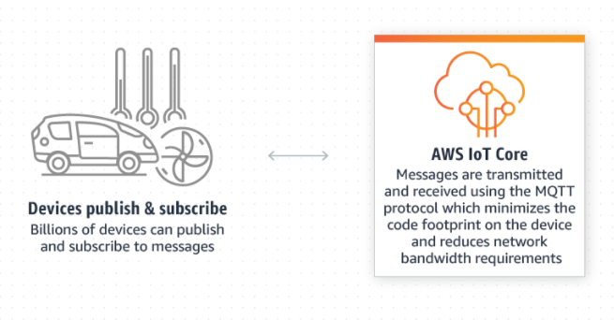
Cloud Platform
AWS IoT Core supports device connections that use the MQTT protocol

Slide 9
Analysis
IoT core provides a JSON file of the MQTT messages transferred , which can be used as an API for analysing and extracting information like
Frequency of a person getting entry
Frequency of Emergency situations
Time of Emergency situations
Frequency of incorrect passwords by each individual
Usual/Unusual Entry Time of individuals
Or
AWS IoT Analytics can also be used to analyse the data collected using MQTT services by creating a rule in AWS IoT Core

Slide 10
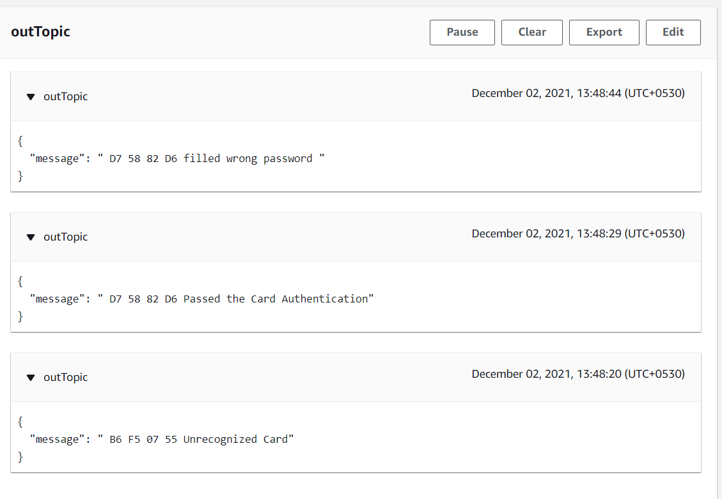
Results
The code written for Arduino UNO and NodeMCU worked well, tested by hardware.
Each Message Generated by Arduino Uno is published to AWS IoT Core using MQTT service to a Topic.
And AWS IoT Analytics is monitoring the data by subscribing to that IoT core Topic.

Slide 11
Hardware Solution

Slide 12
Algorithm
The RFID reader retrieve the information contained by tag as it come in the range of reader.
Board will Check if the UID detected is valid or invalid
if the UID will be Invalid , no further action will be done
if the UID is valid the person have to enter the password ,
if the entered password is correct then the door will be opened by relay and servo motor and an indication will be given using a green LED
if the entered password is wrong , the RED LED will blink and user will have to re-enter the password
if the user tried to enter the wrong password more than 3times then a buzzer will be turned on and the person have to validate their RFID again to enter the password.
Each Log will be sent to AWS IoT Core using MQTT service.

Slide 13
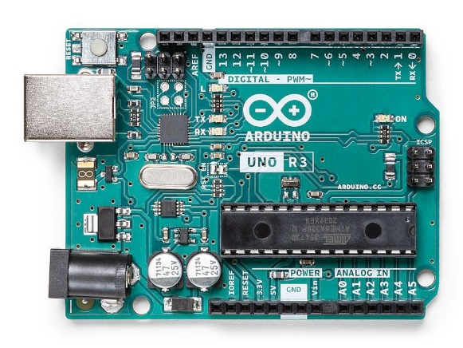
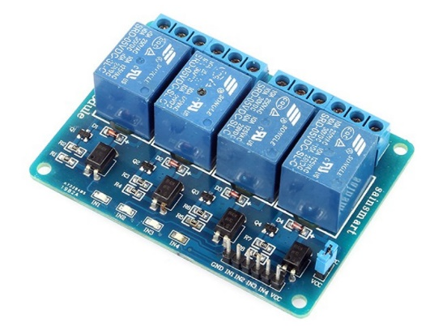
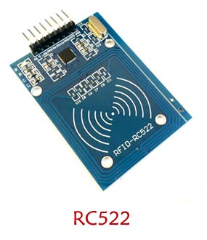
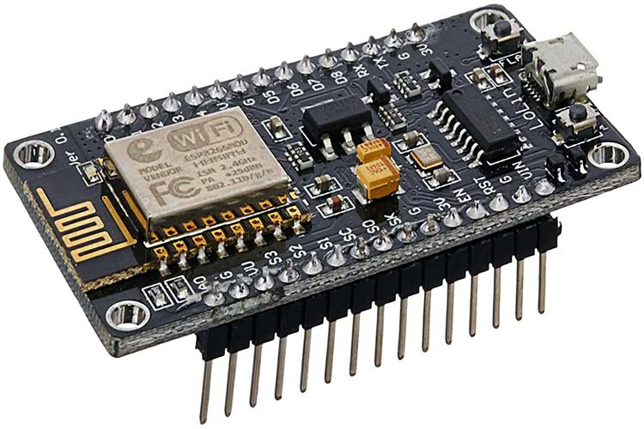
Required Hardware
Arduino Uno
NodeMCU
MFRC522
4x4 Matrix Keypad
LEDs and Buzzer
Servo Motor
Relay Switch
Solenoid Lock
Jumper wires
Resistors

Slide 14
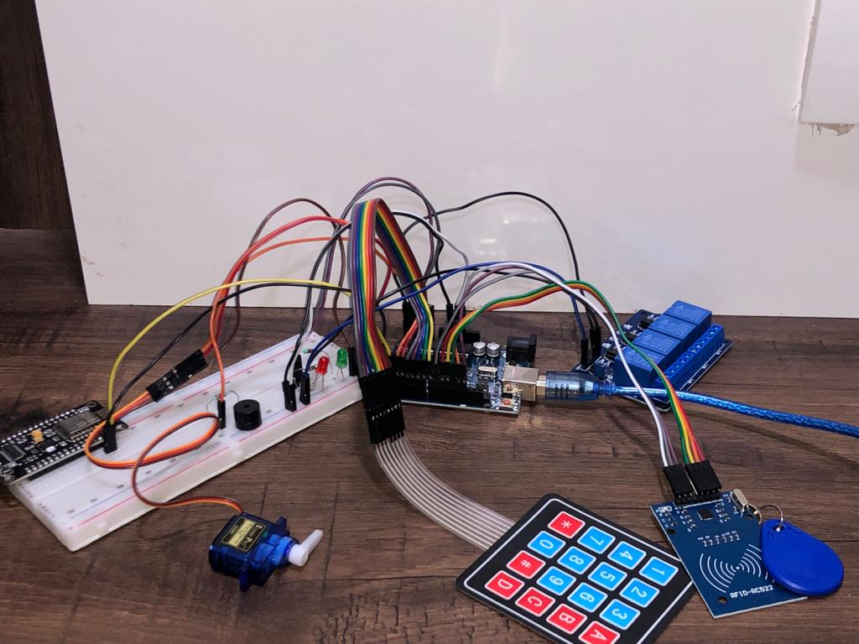
Circuit Connection

Slide 15
Algorithm
The System Validates the UID of the person
Only if the UID is valid, the person will be able to enter the Passcode
The person will can have maximum 3 attempts to fill the passcode and after that UID Tag needs to be verified again
If the person enters the Correct passcode within or less than 3 attempts the Door will be opened.
There will be no action If there is an invalid UID, but the Log will be created.
Each Data will be logged into the cloud at Amazon Web Services (AWS)

Slide 16
Results
The person with invalid RFID is rejected
The person with Valid RFID
Was able to get entry when the entered Passcode is correct
Green LED Turns on
Wasn’t able to get entry if the Passcode if not correct
Red LED turns on
The Person have to validate RFID again if there are more than 3 attempts made for Passcode
Emergency Situation
Red LED blinking
Buzzer Making Noise
Every data is sent to Cloud with a message and the UID scanned by RFID Scanner

Slide 17
Cloud Environment

Slide 18
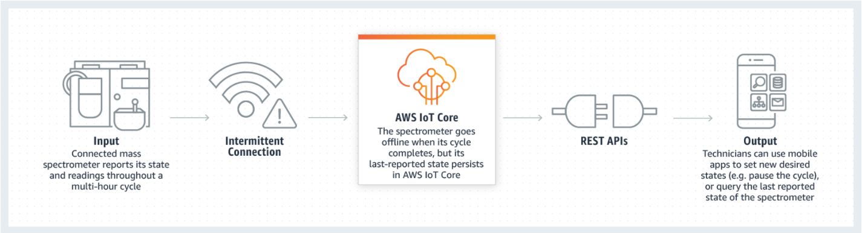
AWS IoT Core
Our System will be publishing the Logs using Wi-Fi Connection
That Logs can be extracted by Subscribing to that Topic
We can Monitor Logs from any corner in the World with internet

Slide 19
Results
Someone with trying to enter with Invalid Card
Some one trying to enter with valid Card ( Passed Authentication)
But filled wrong password for only once and

Slide 20
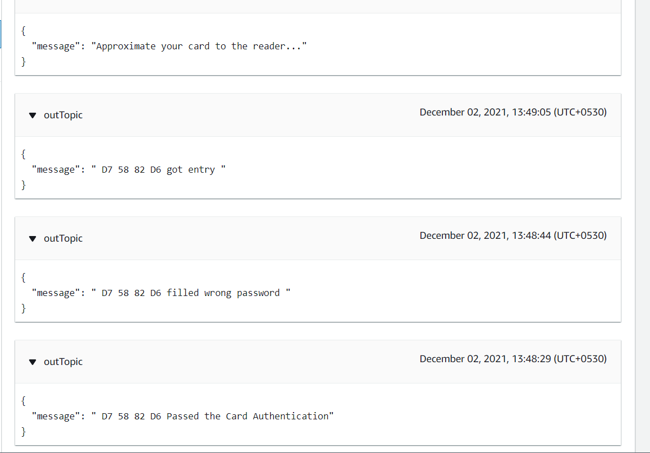
Results
Someone with trying to enter with Invalid Card
Some one trying to enter with valid Card ( Passed Authentication)
But filled wrong password for only once and
Filled correct passcode and got entry

Slide 21
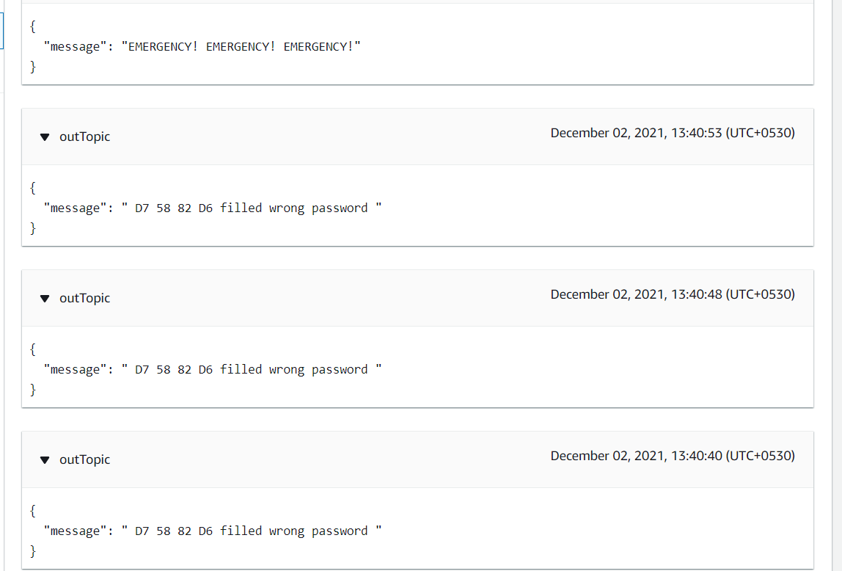
Results
Someone trying to enter after filled wrong password 3 times , Emergency message publish

Slide 22
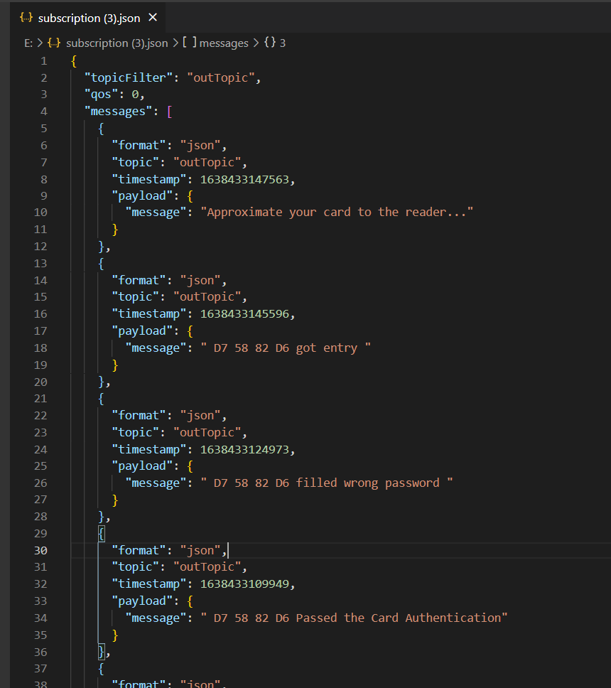
Analysis
IoT core provides a JSON file of the MQTT messages transferred , which can be used as an API for analysing and extracting information like
Frequency of a person getting entry
Frequency of Emergency situations
Time of Emergency situations
Frequency of incorrect passwords by each individual
Usual/Unusual Entry Time of individuals
Or
AWS IoT Analytics can also be used to analyse the data collected using MQTT services.

Slide 23
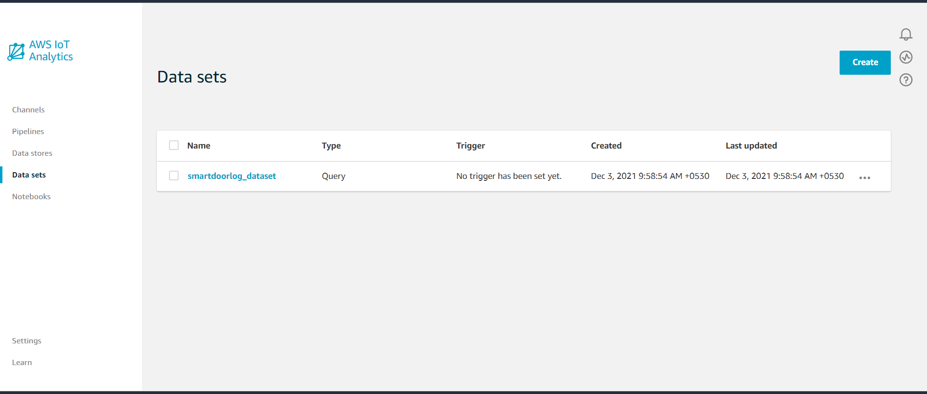
AWS IoT Analytics Platform
AWS IoT Analytics is a fully managed service that operationalizes analyses and scales automatically to support up to petabytes of IoT data. With AWS IoT Analytics, you can analyse data from millions of devices and build fast, responsive IoT applications without managing hardware or infrastructure.

Slide 24
Conclusion
The problem has been formulated and various studies have been reviewed regarding the different electronic lock systems. RFID technology is one of the successfully incorporated in the door lock system. A security mechanism with RFID, Passcode provides two-factor authentication .
Logs can be monitored from anywhere in world with internet.
Finally, a multi-level authentication digital door access control system can be used in critical zones like Military Institute, Defence, Scientific Laboratory, etc too. which is cost effective and increase the scale of security successfully.

Slide 25
Future Scope
A camera/fingerprint module can be used to increase security
Data Generated by AWS IoT Core can be used as an API or can be used to create some specific Web Application or Mobile Application.
Other Modules like GPS, GPRS can be included which will extract the Location by out Mobile and unlock the door for us when we are at some specific distance.

